Slide 1

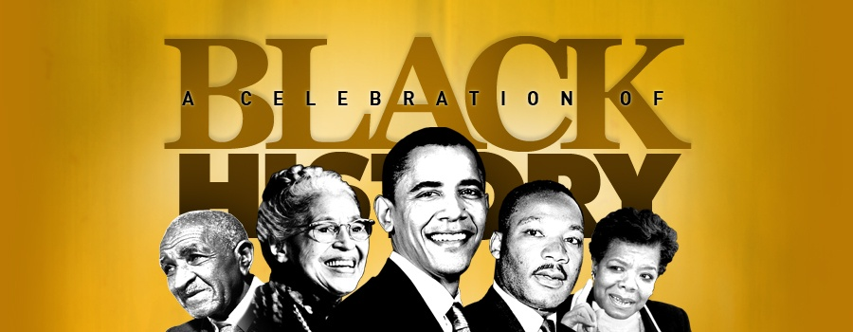
Black History Month
Quang Huynh
Black History Month is an annual (yearly) tradition/occurrence every February that honors accomplishments of Africans Americans, created by Carter G. Woodson, (known as the Father of Black History) and was established in 1976. Also, Black History Month is sponsored by the Association for the Study of African American Life and History, or ASALH, and each year, the ASALH provides a new theme/design.

Slide 2
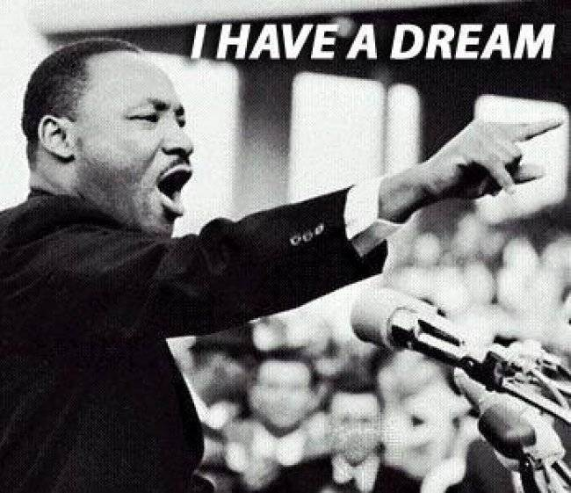
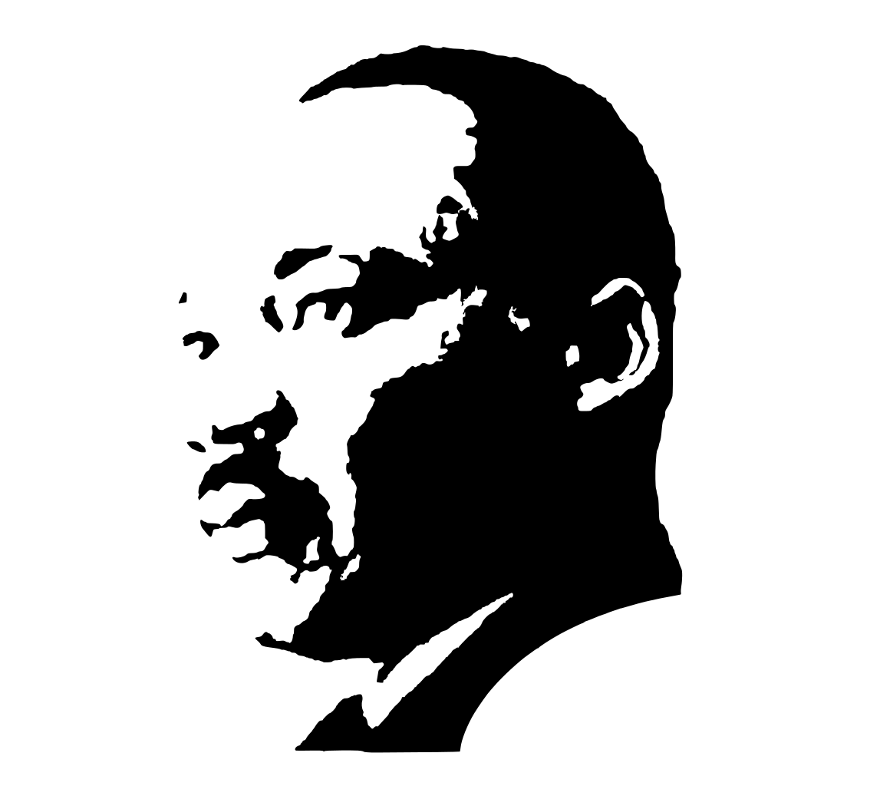
Martin Luther King
His job was a Civil Rights Leader
Lead non-violet protests
Known for his “I Have a Dream” Speech
Was assassinated in Memphis, TN, on April 4, 1968
Over 250,000 people attended his “I Have a Dream” speech.
Born on January 15, 1929, in Atlanta, GA
Went to Booker T. Washington High School
Was at Morehouse College at the age of 15.
Martin Luther King got his PhD from Boston University.
At his time, 1964, he was the youngest person to achieve the Nobel Peace Prize.
Is known by his initials, MLK.
One of MLK’s biggest influences is Mohandas Gandhi.

Slide 3

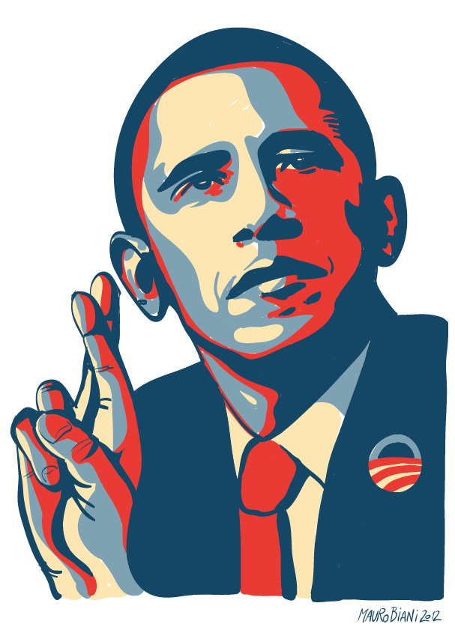
Barack Obama
Was the 44th president of the U.S.
Obama was born in Hawaii.
Barack Obama was most famous for being the first African American to serve our country. (United States)
Obama was in the Democratic party.
Obama graduated from Columbia University in New York in 1983.
Worked for several jobs, finally decided to become a lawyer.
Went to Harvard Law School.
Obama was elected to become a president in 2004.
In 2008, He entered the Presidential Election, and was recognized for being a great speaker.
Obama won against Hilary Clinton in 2009, and then in 2012, he was re-elected, winning again, with Mitt Romney.
Obama likes to play basketball.
Obama’s is a huge sports fan, and his favorite team for baseball are the Chicago White Sox.
Obama used to like Ice Cream, but now, he doesn’t like Ice Cream anymore. ☹

Slide 4
The 14th Amendment
Abraham Lincoln released the slaves without asking congress.
The Amendments freed the slaves, a law that prevents people from owning slaves.
The 14th Amendment was suppose to find a solution to these problems:
Did it free the slaves?
Can slaves own property?
Will society/court treat slaves as white people? Etc.
After the 14th Amendment was signed, racism was still common.
The 14th Amendment is basically a law where everyone is treated equally.
The slaves are free, but there wasn’t a law where it says they can’t had to treat them poorly, so they did that.

Slide 5
Civil War 1861 - 1865
Was fought against the North and the South
This war was caused by Abraham Lincoln in 1860.
The war caused 600,000 lives to be lost.
Also, it caused more than 375,000 people to be injured.
The Confederate States are: Mississippi, Arkansas, Florida, Louisiana, Georgia, Alabama, North Carolina, South Carolina, Tennessee, Virginia and Texas
The North had lots of industry and the South had many farms/agriculture

Slide 6


Notes from encyclopedia/article
Annual, every year in February.
Black History Month is honoring the accomplishments of African Americans.
Was started as an idea in 1926 as Negro History Week, by Carter G. Woodson.
Black History Month was established in 1976.
Black History Month occurs at the same time as Frederick Douglass and Abraham Lincoln, both born in February.
Black History Month is sponsored by the Association for the Study of African Americans (ASALH)
Carter G. Woodson founded the company in 1915 and originally began as the Association for the Study of Negro Life and History. (ATNLH)

Slide 7
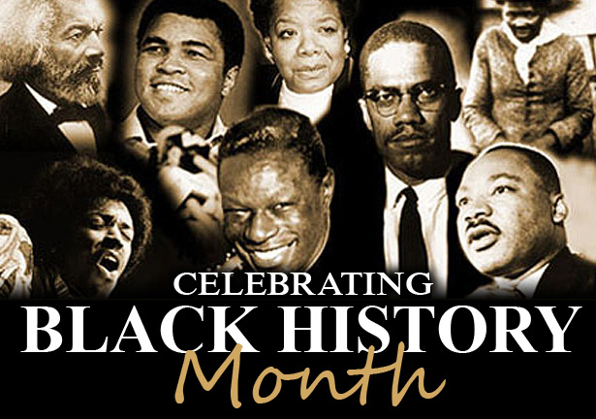
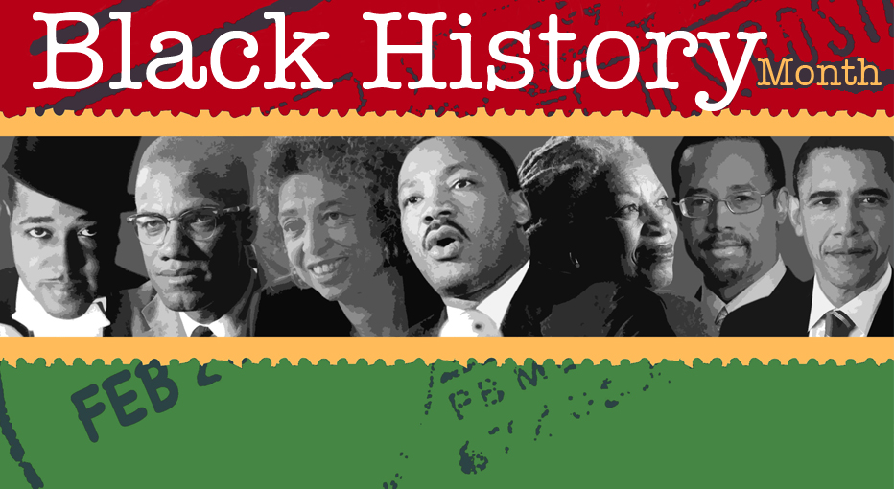
People That Represent Black History Month
Martin Luther King. Jr, is a civil rights activist and led non-violent protests for the rights of African Americans.
Neil deGrasse Tyson, the director of Planetarium, and a scientist, spent most of his career sharing his thoughts to others.
Barack Obama, the 44th president of the United States, is known for being the first African American president.
Harriet Tubman, born a slave in Maryland, had managed to escape slavery by using the "Underground Railroad."
Booker T. Washington, born as a slave and grew up during the Civil War, which meant that Abraham Lincoln had signed the Emancipation Proclamation, and then, when Washington was around nine, he was freed and is no longer a slave.

Slide 8
Works Cited
"Black History Month." World Book. N.p.: n.p., 2010. Print.
"Martin Luther King, Jr." Kid's Biography: Martin Luther King, Jr. Technological Solutions, Inc, n.d. Web. 20 Jan. 2017.
Editors, Biography.com. "Neil DeGrasse Tyson." Biography.com. A&E Networks Television, 21 May 2015. Web. 20 Jan. 2017.
"Biography." Biography of President Barack Obama for Kids. Technological Solutions, Inc, n.d. Web. 23 Jan. 2017.
"Biography." Biography: Harriet Tubman for Kids. Technological Solutions, Inc, n.d. Web. 23 Jan. 2017.
"Biography." Biography: Booker T. Washington for Kids. Technological Solutions Inc, n.d. Web. 23 Jan. 2017.
Malik, Nick. "Explaining the 14th Amendment in Non-Technical English." A Nicklas Malik. N.p., 7 Feb. 2014. Web. 24 Jan. 2017.
"American Civil War Facts, Information & Worksheets | Teaching Resources." KidsKonnect. N.p., 13 Jan. 2017. Web. 24 Jan. 2017.

